Slide 1
Feel the power! Using technology for study and research
Professor James Stanworth (王慕容教授)

Slide 2
1985
2000s

Slide 3
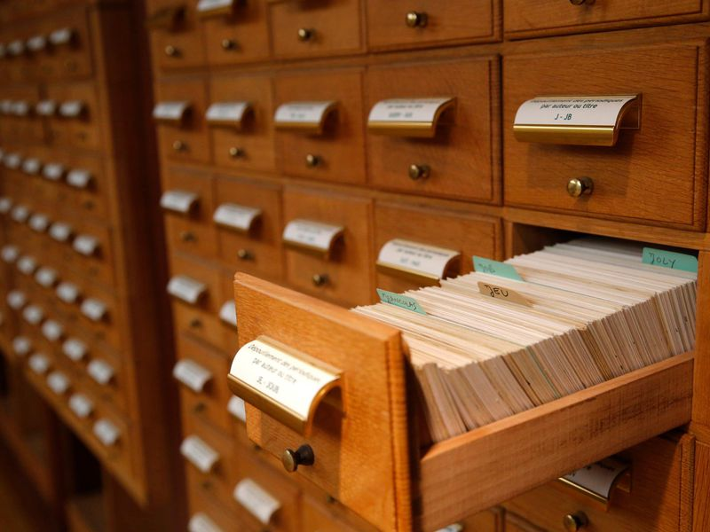
Library
. . . To Google Scholar
From card catalogues . . .
. . . To online catalogues

Slide 4
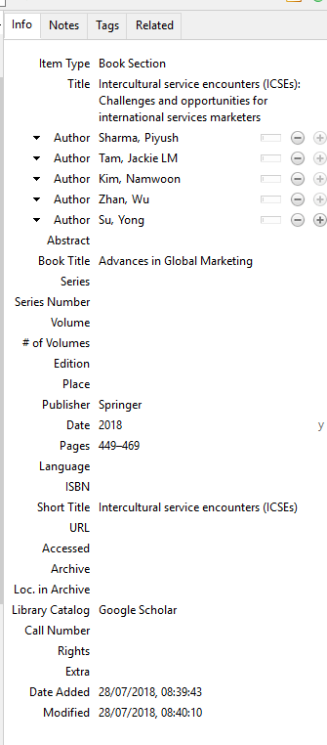
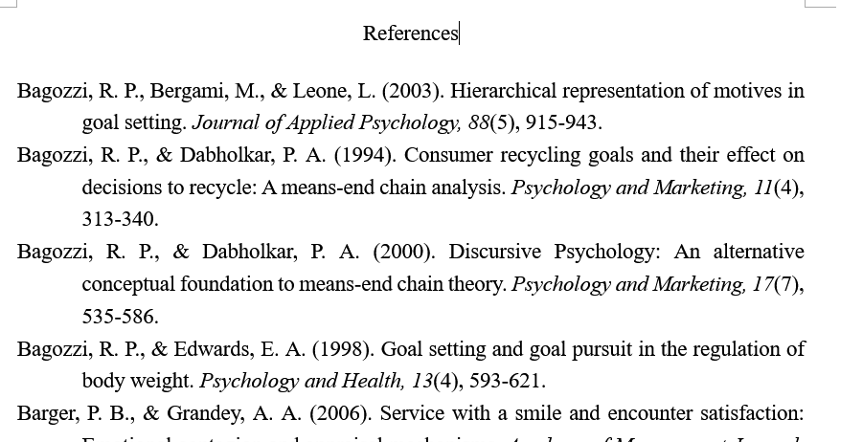
References
From painfully typing references . . .
. . . To using a database – automatically creating reference list

Slide 5
Document preparation
From typewriters . . .
. . . To word processors

Slide 6
Feel the power . . .
Welcome to the 21st century!

Slide 7
Agenda
References for research – a work flow (“SOP”)
(1) Getting references and saving
(2) Getting them into a database
(3) Using references
Using Word to format documents
(1) Creating styles
(2) Inserting figures
(3) Insert table of contents
(4) Insert table of figures

Slide 8
References for research

Slide 9
Getting the reference the power of Google Scholar
Search in scholar
Keywords
Constraint dates
Specify author
Target paper to search for:
Bitner, M. J., Booms, B. H., & Tetreault, M. S. (1990). The service encounter: diagnosing favorable and unfavorable incidents. The Journal of Marketing, 71-84.
Download paper and find it
Rename it
Save it to a folder

Slide 10
Get the reference into a database
Program names: Zotero or Endnote
www.zotero.org
Let’s download and install Zotero
Works best with Firefox web browser
Connection with Google scholar – import the reference

Slide 11
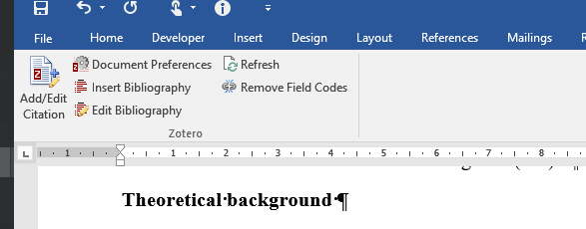
Use the reference
Zotero’s connection to word
Choose a style e.g., APA
“Add citation” to insert the reference
Insert bibliography

Slide 12
Using Word

Slide 13
You … and word?
I am a . . .
1
10
I can turn it on
I can feel the power
Styles, Table numbering, macros are no problem!

Slide 14
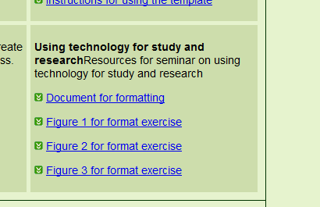
Preparation
Download documents from my website
https://stanworth.site

Slide 15
Building styles
Heading style
Create new style and name
Set font
Set spacing and layout
Use it!
Create a paragraph style
Create new style and name
Set font
Set spacing
Use it
Chapter style
Create new style and name
Set font
Set spacing and layout
Use it!

Slide 16
Inserting figures
Create figure in a drawing program e.g., Microsoft Visio
Workflow - SOP
Save as a picture
Insert the picture in word
Insert a ‘caption”
Create 2 styles – one for the figure and one for the caption

Slide 17
Create and insert table of contents
Insert table of contents
Add our styles into the table of contents

